Slide 1
A multi-criteria contract manufacturing approach in a stochastic manufacturing environment
SMMSO, Volos, 2015
Catherine Decouttere & Nico J. Vandaele, Catholic University of Leuven, GSK Research Chair
Gerd J. Hahn, GGS Heilbronn & Torben Sens, LHConsulting
Notes:
Not mainstream: apply stochastic models for planning
Originates at industry-university link: spin-off; GSK on supply chain design, AC on corporate S&OP planning
Three methodological blocks: milp (gerd and torben) , stoch (nico) and dea (catherine): links and framework: is it feasible

Slide 2
Context of this presentation
Modelling and analysis is the main focus of the field.
Applications for planning have received much less attention.
Implementations of these planning approaches are even more scarce.
Sales and Operations Planning (S&OP) is a mid-term business process considering operational, financial and general Key Performance Indicators (KPI’s).
Relation with previous work:
  Stochastic/deterministtic model has been presented in SMMSO 2013
  Now embed the stochastic models in a scenario framework
  Partially desktop example in the area of contract manufacturing
  First application is underway under a university-industry contract

Slide 3
Objectives of this presentation
Motivate the issue of contract manufacturing and explain its relevance and impact on strategic-tactical planning
Introduce a DEA-based approach for robust multi-criteria
decision-making on top of a combined stochastic MILP model to “evaluate”
strategic decisions at the tactical level
In higher level decision making, we typically face:
  Different stakeholders with different goals which induce different KPI’s
  Decisions which induce design parameters
  Environmental events which induce scenarios
In addition, the approach must be pragmatic and intuitive. It must have communication capabilities.
The example of contract manufacturing is used to illustrate this view point, partially based on a real life case, partially desk-top.
Notes:
DEA: relates anastacia multiple stakeholders in train traffic announcements, kpî’s come in

Slide 4
Contribution
Observations
Context: (S&OP)
Example: contract manufacturing (CM)
Planning is organized in time buckets
Deterministic logic BUT
Transient issues and dynamics are omnipresent
System behavior is a continuous phenomenon
Stochastic logic, BUT
Decisions are taken at specific moments and for specific periods
Combining stochastic and deterinistic modeling
Induces multiple system settings, controllable and uncontrollable
Results in multiple criteria decision making (DEA)
Notes:
Refinements wrt SMMSO 13, DEA is the main addition
DEA can be used to evaluate models:
Manufacturing improvements ➔ R&D
Supply chain: GSK
S&OP

Slide 5
S&OP: a landscape of multiple KPI’s
High
Profitability
Low
Costs
High
Sales
Low Unit
Costs
Quality
Product
High Customer
Service
High
Throughput
High
Utilization
Low
Inventory
Fast
Response
Many
products
Less
Variability
Short
Cycle Times
Low
Utilization
High
Inventory
More
Variability
Modelling tradeoffs is key in S&OP.
However, we will never be able to include all KPI’s in one single model.
Notes:
Model based
Non model based

Slide 6
S&OP: a flow model to balance supply and demand
SKU
Families
BOM
Demand Shaping
Phasing in/out
Mix
Optimal Lot size
Resources
Processes
Setups
Availability
Alternatives
Make or buy
Breakdowns
Scrap, rework
Randomness
Variabilities
Heterogeneity
Complexity
Demand
Supply
Demand
+
+
Supply
Utilization
Lead times
Inventories
Throughputs
Service levels
+
Notes:
Add refenrence

Slide 7
S&OP: a model to connect multiple periods
Contract Manufacturing
In house manufacturing
Demand
Leadtime/Inventory

Slide 8
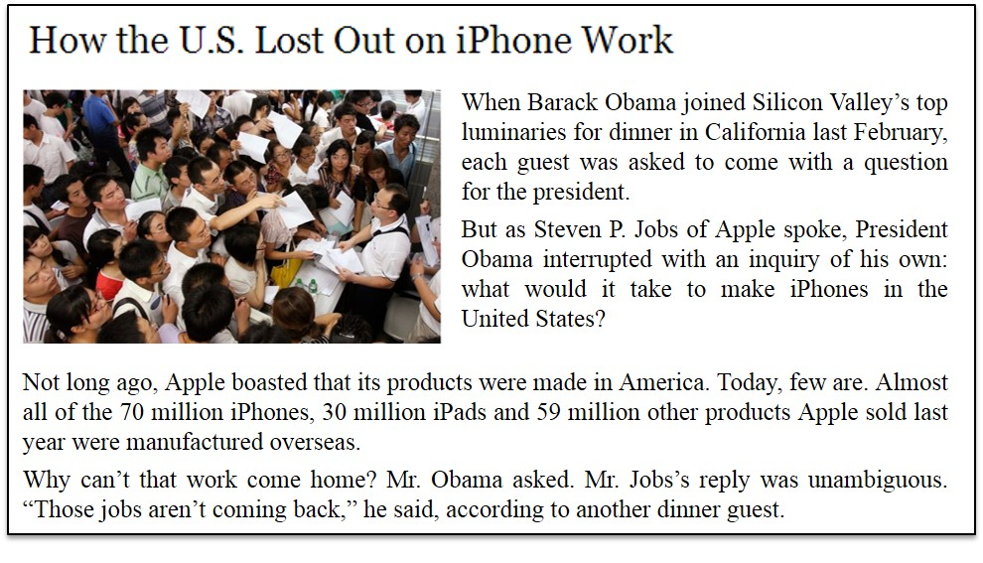
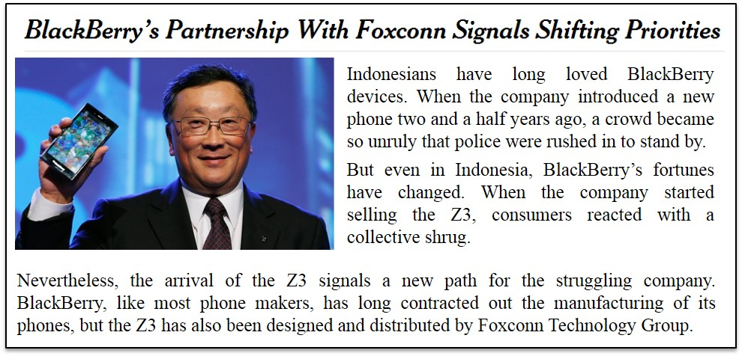
Empirical evidence motivates investigation into the subject of contract manufacturing (CM) and its implications on production management
The New York Times, January 21, 2012 (edited)
General observable trends
USD 342 bn in global sales for the top 25 CMs in 2013, ~30% of the total EMS¹ manufacturing market
US electronics CM market to grow by 39% from 2012 to 2018
Global pharmaceutical CM market with CAGR of ~7% until 2017 with expected market size of USD 18.5 bn
Further industries with similar trend to reduce internal value added: automotive, aerospace, food production, personal care
The New York Times, May 18, 2014 (edited)
Notes:
Quellen: http://mfgmkt.com/mmi-articles.html, http://www.statista.com/statistics/239692/projected-size-of-the-us-electronics-contract-manufacturing-market/, http://de.slideshare.net/FrostandSullivan/global-pharmaceutical-contract-manufacturing-market-injectable-dose-formulations-will-likely-spur-the-growth-of-cm-os

Slide 9

We consider the strategic-tactical issue of contract manufacturing in a stochastic manufacturing environment
Setting
Decision problem
Turnkey (finished goods) CM in contrast to consignment
(components) CM
On-demand manufacturing of variable production volumes given agreed volume corridors and fixed service level agreements
CM with benefits (capacity flexibility, risk transfer) and costs/risks (margin of contractor, quality/reputational threats, IP infringement,…)
Strategic-tactical issue of sourcing is multi-criteria decision problem involving quantitative and qualitative factors: throughput, service, cost, risk, …
Sourcing decisions with massive impact on operational KPIs at shop floor level (lead time, WIP, etc.)
Coordination role of tactical planning: volume/mix decisions impact batch sizes, capacity buffers and lead times (workload-dependent and non-linear)
How to deal with contract manufacturing
in a stochastic manufacturing environment?

Slide 10
Existing literature does not cover a combined robust approach for tactical planning of stochastic manufacturing systems with contract manufacturing options
Description
Selective references
Tactical
Planning
Analytical
  Clearing Functions: Approximation of non-linear relationship between workload and lead time, linearization in APP (single model approach)
  Karmarkar (1987, MS)
  Missbauer (2011, IJPE)
  Selcuk et al. (2008, IIE)
  Multi-model approaches: Iterative solution procedure through analytic approximation of workload-dependent lead times
  Jansen et al. (2013, OR Spec)
  Hahn et al. (2012, OR Proc)
Simulation
  Iterative parameter fine-tuning and system evaluation with Discrete Event Simulation (DES)
  Almeder et al. (2009, OR Spec)
  Gansterer et al. (2014, IJPE)
Contract
Manufactu-
ring, Supplier Selection
  Explicit consideration of subcontracting or capacity management in master planning
  Merzifonluolgu et al. (2007, NRL)
  Kim (2003, IJPE)
  Atamtürk/Hochbaum (2001, MS)
  Carravilla/de Sousa (1995, EJOR)
  Multi-criteria/DEA approaches for structured
  selection of suppliers
  de Boer et al. (2001, EJPSM)
  Dotoli/Falagario (2012, IJPE)
Currently, no combined approach available for robust decision-making accommodating
stochastic manufacturing systems and issues of sourcing/contract manufacturing (or S&OP in general)

Slide 11
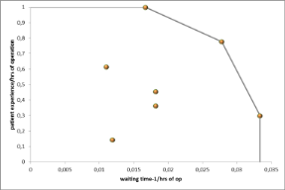
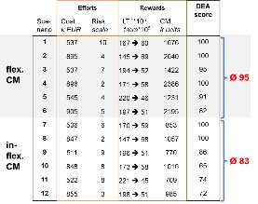
A DEA-based approach is used to provide a robust multi-criteria perspective on the contract manufacturing issue
1
TECH
…
…
…
a. Identify stakeholders
KPI
ECON
…
…
…
b. Define KPIs
HUMAN
…
…
…
2
Generate/evaluate designs (outsourcing options) and scenarios (uncertain parameters)
Model-based KPIs
Non-model-based KPIs
 | M-KPI₁ | M-KPI₂ | … | M-KPI_{p} | N-KPI₁ | N-KPI₂ | … | N-KPI_{q}
Scenario 1
Scenario 2
…
Scenario N
Design I
…
Quantitative Model
(see next slides)
Qualitative Assessment
Design II
3
a. Rank scenarios
b. Select robust
designs
Notes:
Basic idea and approach of the DEA:
1. line up the major stakeholders in the S&OP process 2. derive the KPI's according to these stakeholders, including the metrics used 3. generate scenarios and assess their performance against the metrics of the KPI's; thresholds limit the set of eligible scenarios 4. rank the scenarios in a multi-criteria way 5. make final decision and keep track of some backup scenarios (robustness idea)

Slide 12
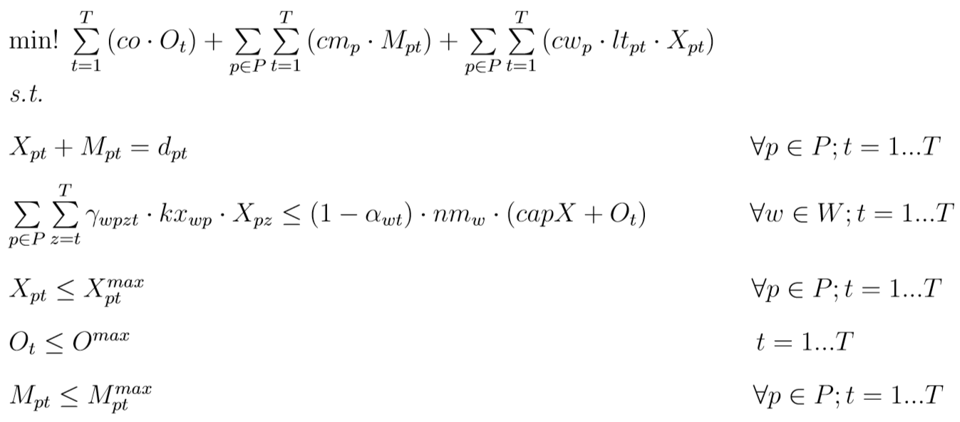
Classical master planning model is enhanced with a queuing networks approach to capture stochastic effects of manufacturing system
Schematic model representation
Description
1/5
APP model
APP: Aggregate Production Planning
Balancing capacity
and WIP costs
Managing volume/mix for internal/external production
Anticipation of actual available capacity and lead times
1/5
Instruction
Expected inter-
arrival times derived from:
  - Production volume
  - Gross capacity
Reaction
  Lead time
  (per backwards scheduling)
  Capacity buffer (incl. setups and technical failures)
2
4
ASQ: Aggregate Stochastic Queuing
Stochastic lot-sizing model for job shop (queuing network)
Approximation of operational KPIs
Conducted separately per APP time bucket
3
ASQ models
per period t = 1..T
3
…
t = T
t = 3
t = 2
t = 1
Notes:
Based on the remarks, we refined the model lead time putting volumes in particular periods
SIPP: stationary independent per period

Slide 13

A standard APP model is modified to better anticipate actual capacity available and lead times according to production volumes
Aggregate Production Planning model
  Model considers WIP costs according to lead time
capacity cost
WIP cost
  Model anticipates actual capacity available and average lead times
  Objective function minimizes capacity and WIP cost, thereby implicitly minimizing manufacturing lead times
  Binary capacity use offset γ allocates capacity demand to the respective period
  Capacity buffer α accommodates for setup losses and technical failures

Slide 14
An ASQ model for optimal order batching in a job shop environment is applied to approximate capacity buffer and lead times
Aggregate Stochastic Queuing Model
  Expected weighted lead Time E(Θ) as a function of batch size Q consists of waiting time to batch (wb), waiting time in queue (wq), and setup and processing time (st, pt)
  Constant batch size Q for whole routing is assumed

Slide 15
A DEA-based approach is used to provide a robust multi-criteria perspective on the contract manufacturing issue
1
TECH
…
…
…
a. Identify stakeholders
KPI
ECON
…
…
…
b. Define KPIs
HUMAN
…
…
…
2
Generate/evaluate designs (outsourcing options) and scenarios (uncertain parameters)
Model-based KPIs
Non-model-based KPIs
 | M-KPI₁ | M-KPI₂ | … | M-KPI_{p} | N-KPI₁ | N-KPI₂ | … | N-KPI_{q}
Scenario 1
Scenario 2
…
Scenario N
Design I
…
Quantitative Model
(see next slides)
Qualitative Assessment
Design II
3
a. Rank scenarios
b. Select robust
designs
SOURCE: Vandaele/Decouttere/Lemmens/Bernuzzi (2014, 2015), Advances in Humanitarian Operations, Springer.
Notes:
Basic idea and approach of the DEA:
1. line up the major stakeholders in the S&OP process 2. derive the KPI's according to these stakeholders, including the metrics used 3. generate scenarios and assess their performance against the metrics of the KPI's; thresholds limit the set of eligible scenarios 4. rank the scenarios in a multi-criteria way 5. make final decision and keep track of some backup scenarios (robustness idea)

Slide 16
A numerical example is used to evaluate the combined approach
Case example
Job shop with 12 products from 4 families and 10 machines
Fixed linear routing with 7 or 8 out of 10 machines
Make to order environment
Customer demand is dynamic
Setup times are stochastic
Processing times are deterministic
Regular capacity is 160 hours a month before machine availability
280 hours is max overtime

Slide 17
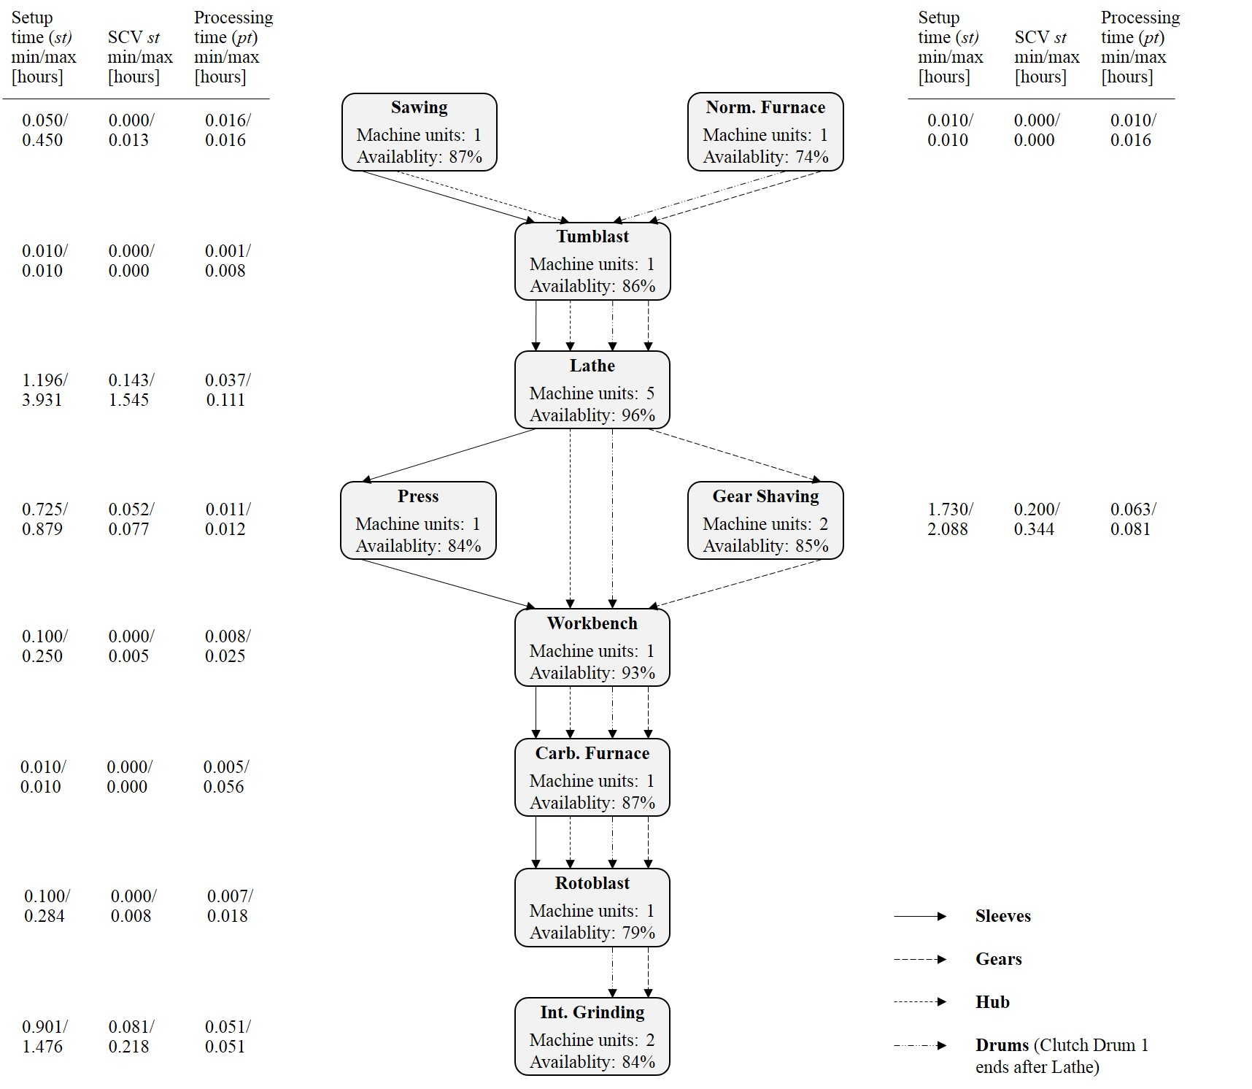
Notes:
Min max: over de 12 producten een setup met gemiddelde tussen 0.05 en 0.45 en een squared coefficient of variation between 0 en 0,013
Processing time between 0.016 en 0.016 (hier dus deterministisch en voor alle producten gelijk)

Slide 18
Design options – Scenarios
Full factorial design
Internal controllable factors – Design options
Sourcing option |  | Setup variability
Inflexible | specialized in 1 product with limited capacity and low unit costs | Low | x from base case
Flexible | covering all products, higher dedicated capacity, high unit costs | Moderate | 0,3 + 1,2x
Mixed | both are allowed | High | 0,8 + 2x
External factors - Scenarios
Demand variability |  | Demand Seasonality
Deterministic | SCV = 0 | Flat | 10% min-max
Moderate | SCV = 1,0 | Fluctuating | 30% min-max
High | SCV = 2,5
54 Design – Scenario combinations

Slide 19
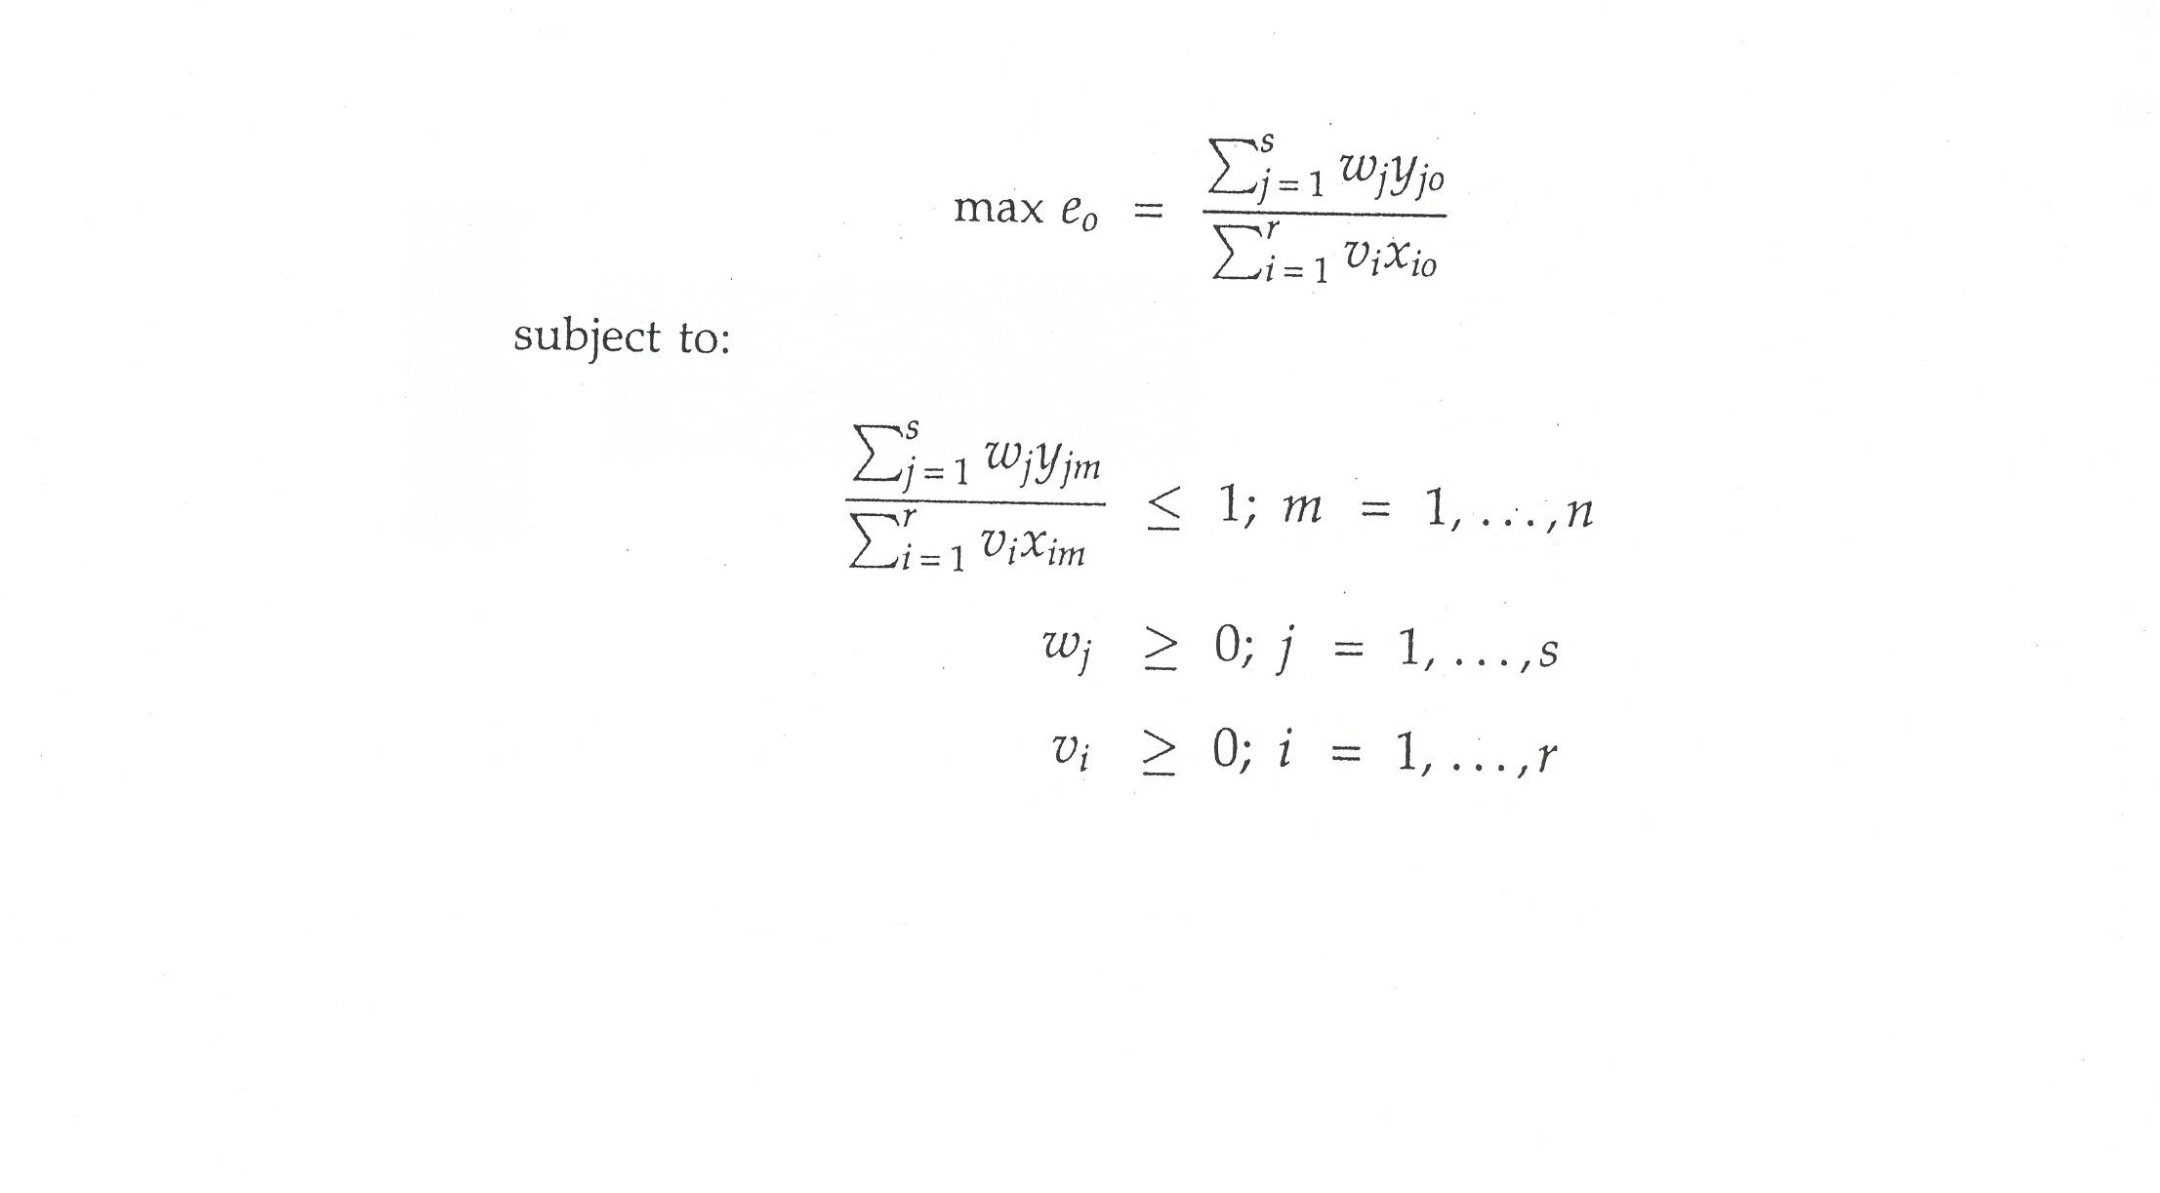
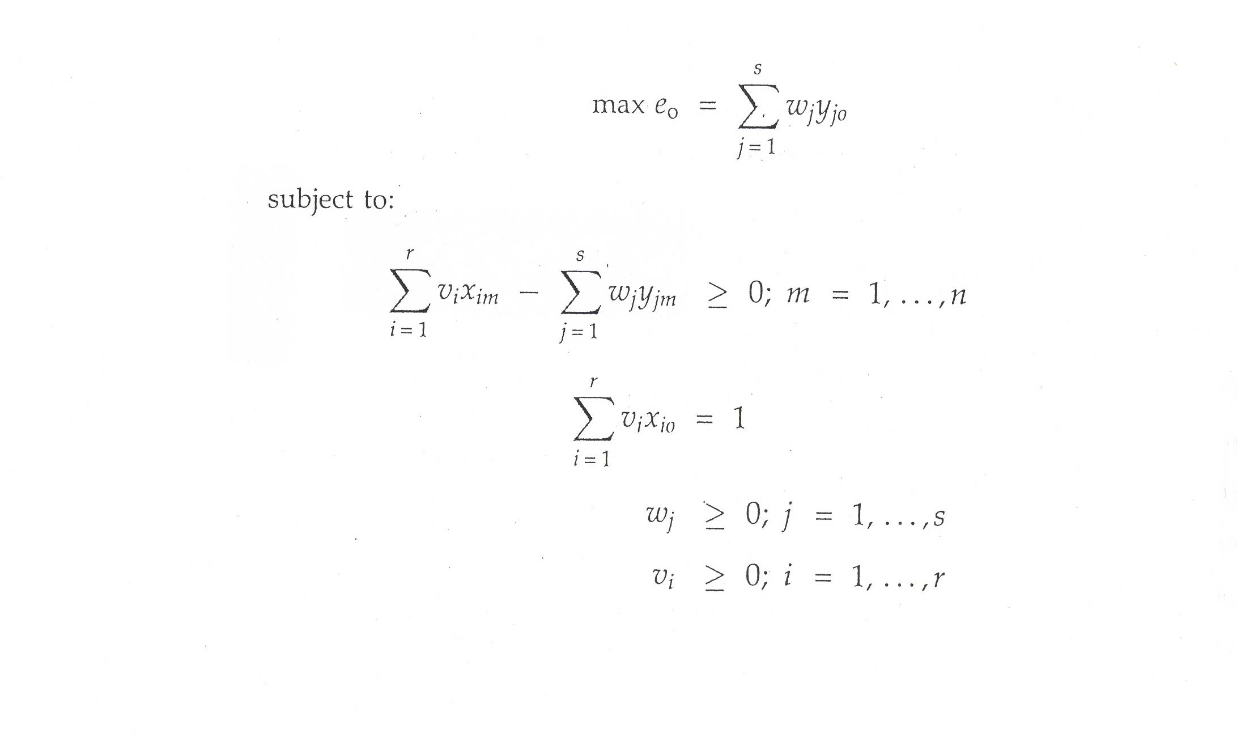
DEA Formulation
CCR model: Charnes, Cooper & Rhodes [1978]
CRS, Input oriented, Radial
e.r.b. T.T.
Problem formulation
LP formulation
Vandaele N., Decouttere C., ‘Sustainable R&D portfolio assessment’, Decision Support Systems, 2012

Slide 20
Multi criteria evaluation model:
Data Envelopment Analysis (DEA)
CCR model: Charnes, Cooper & Rhodes [1978]
CRS, Input oriented, Radial
Vandaele N., Decouttere C., ‘Sustainable R&D portfolio assessment’, Decision Support Systems, 2012
Notes:
CCR model: Charnes, Cooper and Rhodes [1978]
CRS constant returns to scale
Input oriented
Radial
BCC model: Banker, Charnes and Cooper [1984]
VRS variable returns to scale
Input oriented
Radial

Slide 21
Numerical example:
inputs and outputs for DEA
S&OP stakeholders:
“Become as responsive as possible by using outsourcing for the lowest cost and technical risk”
Inputs
“efforts”
Outputs
“rewards”
Costs
APP-ASQ model
CM volume
Lead times
optimal cost
Technical risk
Efficiency?

Slide 22
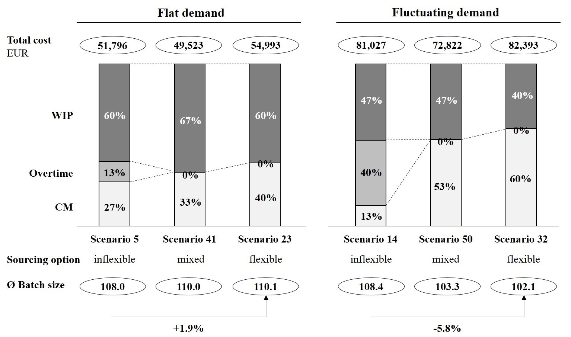
APP-ASQ deep dive
Notes:
Inflexible: overtime is preferred over cm whilst mixed and flex beat overtime
Mixed turns out to be cheapest
flex: most cost
Lot sizes play a dampening role
Fluct versus flat: more expensive; more on CM

Slide 23

Multi dimensional efficiency

Slide 24
Scenario data and efficiency

Slide 25
Scenario list

Slide 26
Efficiency analysis
Inflexible supplier
Flexible supplier
Mixed supplier
LMH
Setup variability
Flat
Fluct
Flat
Fluct
Flat
Fluct
Demand seasonality
lo
mo
hi
lo
mo
hi
lo
mo
hi
lo
mo
hi
lo
mo
hi
lo
mo
hi
Demand variability
Notes:
Flow: Over alle periodes kosten minimaliseren (APP)

Slide 27
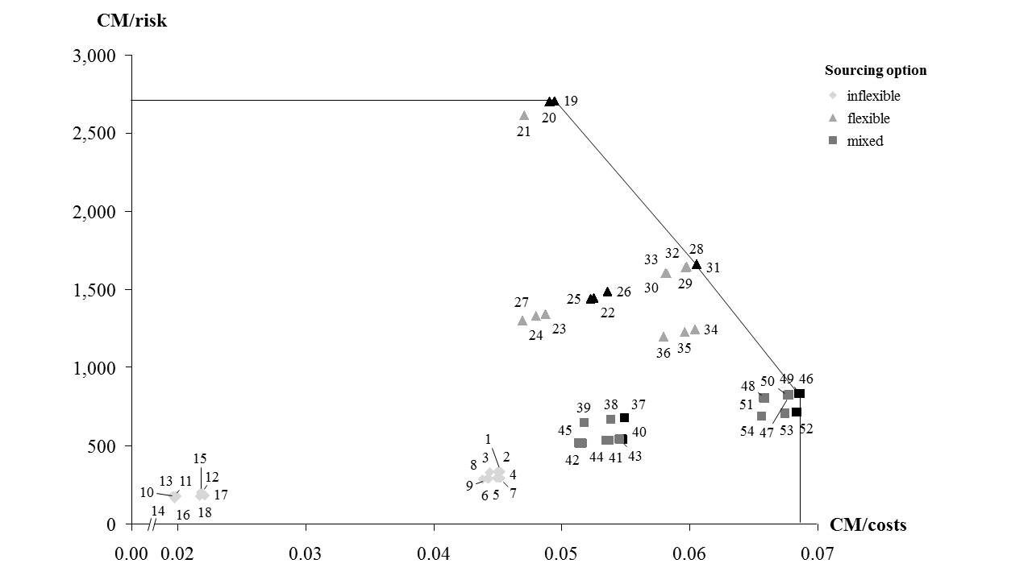
Contracted volume versus risk and cost
Flex supplier
Flat seasonality
Low demand variability
Flex supplier
Fluct seasonality
Flex supplier
Flat seasonality
Mod-Hi demand variability
Inflex supplier
Mixed supplier
Fluctuating seasonality
Mixed supplier
Flat seasonality

Slide 28
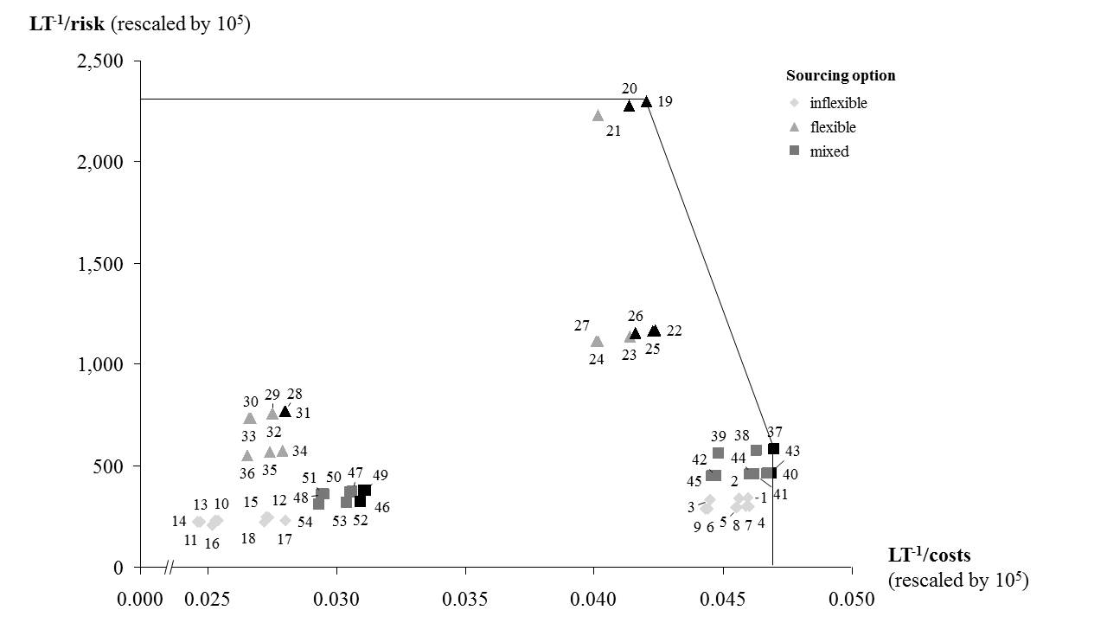
Lead time⁻¹ versus risk and cost
Flex supplier
Flat seasonality
Low demand variability
Flex supplier
Flat seasonality
Mod-Hi demand variability
Flex supplier
Fluct seasonality
Mixed supplier
Flat seasonality
Mixed supplier
Fluctuating seasonality
Inflex supplier
Fluct seasonality
Inflex supplier
Flat seasonality

Slide 29
Conclusions
S&OP
  Stochastic model per period
  Deterministic model connecting the periods
  Non Parametric approach: multiple KPI’s
Illustration by Contract Manufacturing, more widely applicable
Current/Future:
  Refinements
  Convergence
  KPI assessments
  Full real life case
Notes:
Case atlas copco.

Slide 30
Questions? nico.vandaele@kuleuven.be catherine.decouttere@kuleuven.be

Slide 31
external
calculated
efforts
Scenario generation
decision
datatable
rewards
flowscen
Allscen
(flow + fin)
finscen
Demand uncertainties
(market evolution, demand pattern)
Production allocation policy
(on time, before)
Stock policy CC
Cost of labour
(std, timebank, temp)
Source of labour policy
(fraction TB & temp)
Flow model
(monthly, product family)
Takt
HR hrs
std & overtime
Financial model AC
Data AC
flowfin
WIP capital cost
flowDEA
finDEA
WIP cost
PC
WIP cost
CC
HR cost
(std,TB,TMP)
Service level
Internal profit
Responsiveness
Customer Satisfaction
DEAscen
Multi criteria evaluation model
(yearly, company level)

